Slide 1

HTML5 & CSS3
Fundamentals
Week 1 – Day 2

Slide 2
Welcome
Tanveer Ahmad
Technical Trainer
DPP

Slide 3

CSS the Basics
CSS: Cascading Style Sheets
We can separate mark-up and styling code
Link our styles to our webpage
Manipulate the layout of our webpage
Style different elements within our webpage
CSS3 History

Slide 4
CSS stands for Cascading Style Sheets
CSS describes how HTML elements are to be displayed on screen, paper, or in other media.
CSS can be added to HTML elements in 3 ways:
Inline - by using the style attribute in HTML elements
An inline CSS is used to apply a unique style to a single HTML element.
Internal - by using a <style> element in the <head> section
An internal CSS is used to define a style for a single HTML page.
External - by using an external CSS file
An external style sheet is used to define the style for many HTML pages.

Slide 5
The CSS Box Model
Margin
Border
Padding
Content

Slide 6
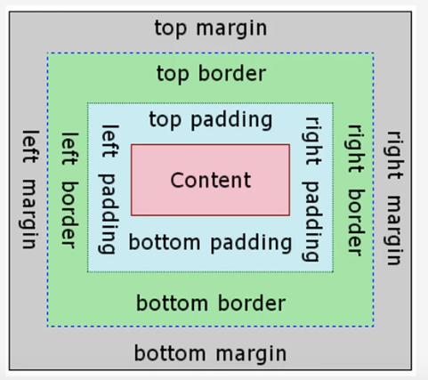
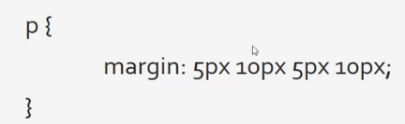
The CSS Box Model
(Top, Right, Bottom, Left) Margins

Slide 7
HTML <blockquote> for Quotations
The HTML <blockquote> element defines a section that is quoted from another source.
<p> Browsers usually indent blockquote elements.</p>
<blockquote cite="http://www.worldwildlife.org/who/index.html">
For 50 years, WWF has been protecting the future of nature.
The world's leading conservation organization,
WWF works in 100 countries and is supported by
1.2 million members in the United States and
close to 5 million globally.
</blockquote>

Slide 8
Units
em: The “em” is a scalable unit that is used in web document. An em is equal to the current font-size, for instance, if the font-size of the document is 12pt, 1em is equal to 12pt. Ems are scalable in nature, so 2em would equal 24pt.
mobile-device-friendly
Points (pt): Points are traditionally used in print media (anything that is to be printed on paper, etc.).
One point is equal to 1/72 of an inch.
Pixels (px): Pixels are fixed-size units that are used in screen media (i.e. to be read on the computer screen).
One pixel is equal to one dot on the computer screen.
Percent (%): The percent unit is much like the “em” unit.
the current font-size is equal to 100% (i.e. 12pt = 100%)

Slide 9
Difference between em and rem
“em” is relative to the font-size of the nearest or parent element
“rem” is relative to the html (root) font-size (the entire page).
This is important when intermediate containers change font sizes. Child elements with EMs will be affected, those using REMs will not.
em is relative to the nearest parent in CSS, while rem is relative to the parent of the page which is usually the html tag...

Slide 10
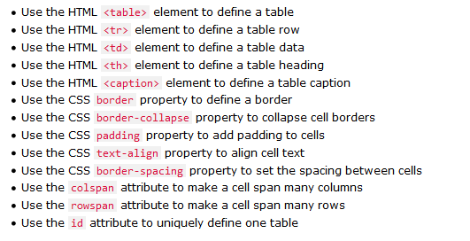
HTML Table
An HTML table is defined with the <table> tag.
Each table row is defined with the <tr> tag.
A table header is defined with the <th> tag. By default, table headings are bold and centered.
A table data/cell is defined with the <td> tag.

Slide 11
Google Map
<iframe src="https://www.google.com/maps/embed?pb=!1m18!1m12!1m3!1d39727.801850338845!2d-0.1121902814685847!3d51.513443200870476!2m3!1f0!2f0!3f0!3m2!1i1024!2i768!4f13.1!3m3!1m2!1s0x4876034c93ce51cd%3A0x839c60d47355ae7a!2sAldgate%2C+London!5e0!3m2!1sen!2suk!4v1560197259290!5m2!1sen!2suk" width="600" height="450" frameborder="0" style="border:0" allowfullscreen> </iframe>

Slide 12
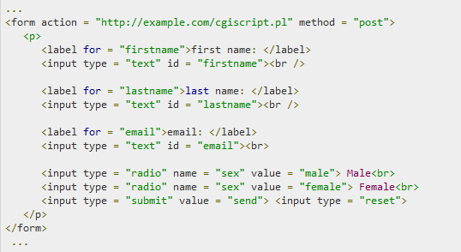
Form with input fields

Slide 13
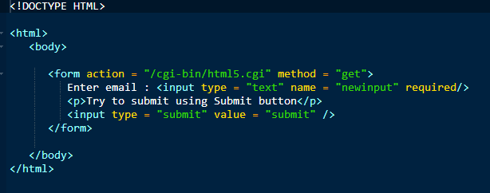
The required attribute
HTML5 introduced a new attribute called required which would be used as follows and would insist to have a value

Slide 14
Youtube video
Autoplay attribute
Value 0 (default): The video will not play automatically when the player loads.
Value 1: The video will play automatically when the player loads.
<iframe src=https://www.youtube.com/embed/tgbNymZ7vqY?autoplay=1 width=“600" height=“450" > </iframe>

Slide 15
HTML5 Semantic Elements
Semantic elements (tags) = elements (tags) with a meaning.
A semantic element clearly describes its meaning to both the browser and the developer.
Examples of non-semantic elements: <div> and <span> - Tells nothing about its content.
Examples of semantic elements: <form>, <table>, and <article> - Clearly defines its content.
Many web sites contain HTML code like: <div id="nav"> <div class="header"> <div id="footer"> to indicate navigation, header, and footer.

Slide 16
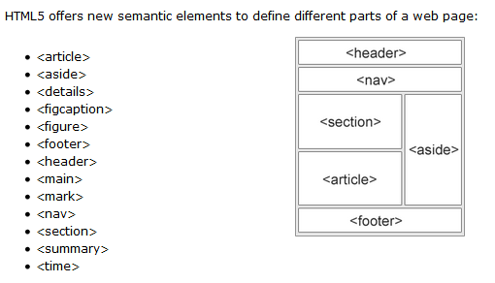
HTML5 semantic elements

Slide 17
<section>
The <section> element defines a section in a document.
A section is a thematic grouping of content, typically with a heading.
A home page could normally be split into sections for introduction, content, and contact information.
<section> <h1>Contact </h1> <p> You can contact us by email address and the phone number provided below………………….... </p> </section>

Slide 18
<article>
The <article> element specifies independent, self-contained content.
Examples of where an <article> element can be used:
Forum post
Blog post
Newspaper article
<article> <h1>What is HTML?</h1> <p> Hypertext Mark-up Language ……………………</p> </article>
You will find HTML pages with <section> elements containing <article> elements, and <article> elements containing <section> elements.
You will also find pages with <section> elements containing <section> elements, and <article> elements containing <article> elements.

Slide 19
Bookmarks in html (<a> tag
HTML bookmarks are used to allow readers to jump to specific parts of a Web page.
To make a bookmark, you must first create the bookmark by assigning an ID to the part/section/div, and then add a link to it using <a> tag.
Example
Link created
<h2 id=“para4"> Paragraph 4 </h2>
Link to bookmark
<a href="# para4 ">Jump to paragraph 4</a>

Slide 20
Google fonts
Go to: https://fonts.google.com/
Click on “See Specimen” of the font you like
+ Select this font
Click on selected font
Click on @IMPORT link
Copy the code between <style> </style> tags
Example:
@import url('https://fonts.googleapis.com/css?family=Source+Sans+Pro&display=swap’);
Paste it on the top of the style.css
Font is ready to use i.e.
font-family: 'Source Sans Pro','Roboto Condensed', sans-serif;

Slide 21
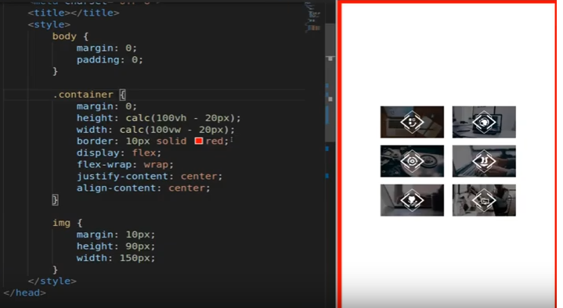

Slide 22
Useful Websites
https://www.tutorialspoint.com/html5/html5_web_forms2.htm

